Slide 1
N-600 Training
Goodwin Procter LLP • October 21, 2014
Allison Roso, Greater Boston Citizenship Initiative
Michele Kane, Irish International Immigrant Center

Slide 2
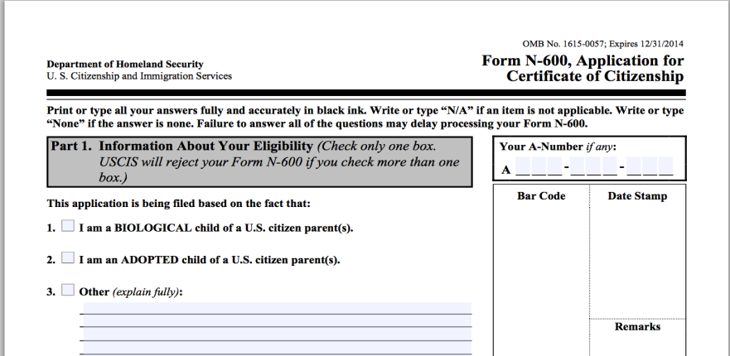
N-600 Application
Notes:
The N-600 is an application to obtain a certificate of citizenship. It is used by people who are already U.S. citizens due to the fact that one or both of their parents were/are U.S. citizens, but never obtained proof of their citizenship. This is the reason that the N-400 asks whether the applicants parents were married before the age of 18, and whether either of the applicant’s parents were or are U.S. citizens.

Slide 3
Applicants
There are two types of applicants who may obtain proof of their U.S. citizenship through the N-600.
  Those who acquired citizenship at birth.
  Those who derived citizenship through their parents.
Parents may also fill out the N-600 on behalf of their minor child.

Slide 4
Acquisition: Basic Elements
Child acquired U.S. citizenship at birth.
  Child was born outside of the U.S.
  Biological child of a U.S. citizen (USC) parent.
  Different criteria depending on whether the child was born in or out of wedlock.
If neither parent was a USC when the child was born, refer to derivation.
Notes:
1 – means outside of the contiguous United States and its territories
2 – both parents do not need to be USC, but if one parent is not a USC (national/no status/LPR), the child must be the biological child of USC. Does not apply to adopted children
3 – more requirements if child was born to USC father than USC mother

Slide 5
Acquisition: Questions to Ask
The law in effect at the applicant’s date of birth controls.
Questions:
  When were you born?
  Where were you born?
  Was your biological mother and/or father a U.S. citizen?
  Were your parents married when you were born?
  Did your USC parent ever live in the U.S.?
Refer to Chart A or B to determine the requirements for acquisition based on when the applicant was born.
Notes:
3 – Law has changed over time, last time being Nov. 14, 1986 (Citizenship at Birth Abroad – Chart A)

Slide 6
Acquisition: In Wedlock
For example, for an applicant born after Nov. 14, 1986:
Two USC parents
  One parent must have resided in the U.S. or its possessions at any time before the child’s birth.
One USC parent and one national parent
  USC parent must have been physically present in the U.S. for at least one continuous year before the child’s birth.
One USC parent and one noncitizen parent
  USC parent must have at least 5 years of physical presence in the U.S. before the child’s birth.
    2 of the 5 years must be after the USC parent is 14 years old.
Chart A
Notes:
All of these requirements are explained in Chart A, which is included with your handouts
National: all USC, and other persons who owe allegiance to the US but have not been granted the privilege of citizenship (American Samoa, Swains Island)
Residence: means the place of general abode; the place of general abode of a person means his principal, actual dwelling place in fact, without regard to intent

Slide 7
Hypothetical #1
In 1970, at the age of 10, Natasha immigrated to the U.S. with her parents from Russia. While in the U.S., Natasha became a naturalized U.S. citizen.
Unable to find a suitable husband, Natasha returned to Russia in 1985. Back in Moscow, Natasha met Alexander, fell in love and married.
In 1995, in Moscow, Natasha gave birth to a son, Ivan.
Is Ivan a U.S. citizen?
U.S. Citizenship E-Learning Course, Catholic Legal Information Network, Inc.

Slide 8
Hypothetical #1: Answer
Yes! Ivan acquired U.S. citizenship at birth.
Ivan’s mother is a USC and he was born in wedlock.
  Look at Chart A
Ivan was born in 1995.
  Look at the last row, Born on/after 11/14/1986
It does not say whether Ivan’s father is a USC, but assuming not, Ivan has one USC parent and one noncitizen parent.
Requirement is that Natasha must have been physically present in the U.S. for 5 years.
  Present in the U.S. from 1970 to 1985 (15 years)
  Lived in the U.S. from age 10 to 25 (at least 2 years after age 14)

Slide 9
Acquisition: Out of Wedlock
USC Mother
(after December 24, 1952)
Mother must have been physically present in the U.S. or possessions for at least one continuous year, at any time before the child’s birth.
Chart B, Part 1
Notes:
All of the requirements are explained in Chart B
Mother: requirements have not changed very much over time

Slide 10
Acquisition: Out of Wedlock
USC Father
(after November 15, 1971)
Clear evidence of blood relationship with father.
Before the child turns 18, one of the following must occur:
  Child is legitimated under law of child’s residence
  Father acknowledged paternity under oath
  Paternity established by court
Father must agree under oath to provide financial support until the child turns 18.
Father must meet all presence requirements
(according to Chart A).
Chart B, Part 2
Notes:
Requirements have varied over time, due to issues of paternity/legitimation, and also the age of support (previously 21 years)

Slide 11
Legitimation
Laws vary from state to state and country to country.
Child must be legitimated under the law of the child’s residence or domicile.
If there is no distinction in the law between legitimate and illegitimate children, legitimation is deemed to have occurred by operation of law.
Possible examples:
  Listed as father on birth certificate
  Voluntary acknowledgement
  Parents subsequently marry
  Acknowledgement via judicial action and judgment

Slide 12
Derivation
Look to the law in effect when the last qualifying condition was met.
Refer to Chart C to determine the requirements for when the applicant met the last condition.
  Child Citizenship Act of 2000 (February 27, 2001)
Previously, illegitimate children could not derive citizenship.
  Under the current law, the child can derive so long as they were legitimated before age 16 and meet all other requirements under the current law.
Notes:
It does not matter in which order the conditions are met so long as they occur before the child turns 18 – for example, the child could be living in the U.S. as an LPR when the parent naturalizes, or the parent may be living in the U.S. as a citizen when the child receives their green card abroad and comes to live with their parent
Last time the law changes regarding derivation was the Child Citizenship Act of 2000, which was effective on Feb. 27, 2001. If a person was under the age of 18 before this date and all of the requirements were met, they could obtain a certificate of citizenship through the N-600, even if they are now over the age of 18. But, if all of the requirements were not met by the effective date, the person would need to obtain citizenship through the N-400.

Slide 13
Derivation
Requirements under the Child Citizenship Act
Can be met in any order
Child derived U.S. citizenship after birth but before age 18:
  At least one parent is a USC, either by birth or through naturalization
  Child is lawfully admitted to U.S. as an LPR
  Child is not married
  Child is living in the legal and physical custody of the USC parent in the U.S.
Applicable to adopted children, but not stepchildren.
Chart C
Notes:
Requirements can be found in the attached Chart C
Adopted children cannot acquire citizenship, but they may derive citizenship through their USC adoptive parent (so long as the adoption is final before the child turns 16)

Slide 14
Derivation: Definitions
Legal Custody
Physical Custody
Parent has the legal responsibility for and authority over the child.
Massachusetts: right and responsibility to make major decisions regarding the child’s welfare including matters of education, medical care and emotional, moral and religious development.
Not defined in regulations
Residing permanently in the U.S. with the citizen parent, pursuant to a lawful admission as LPR.
Massachusetts: child shall reside with and be under the supervision of parent

Slide 15
Hypothetical #2
Eva was born in Argentina on September 3, 1996.
In 2002, Eva and her parents entered the U.S. as LPRs, based on a petition filed by her mother’s sister.
On February 27, 2011, Eva’s mother naturalized. Her father is still an LPR.
Eva has always lived with her parents in the U.S.
Is Eva a U.S. citizen?
U.S. Citizenship E-Learning Course, Catholic Legal Information Network, Inc.

Slide 16
Hypothetical #2: Answer
Yes! Eva derived U.S. citizenship from her mother.
Neither parent was a USC when Eva was born.
  Look at Chart C, last row (meets requirements on/after 2/27/2001).
She was living under the legal and physical custody of her parents in the U.S.
She is an LPR.
She is not married.
Eva’s mother naturalized on February 27, 2011.
  Eva was 14 years old when the last condition was met.

Slide 17
Hypothetical #3
Sophia was born in Italy on September 21, 1982.
She immigrated to the United States on June 17, 1992 based on a relative petition filed by her LPR father. Sophia’s mother also immigrated at that time.
On May 1, 1998, Sophia’s father became a U.S. citizen. Sophia’s mother is still an LPR.
Is Sophia a U.S. citizen?
U.S. Citizenship E-Learning Course, Catholic Legal Information Network, Inc.

Slide 18
Hypothetical #3: Answer
No! Sophia did not derive U.S. citizenship from her father. She must naturalize on her own.
Neither parent was a USC when Sophia was born.
  Look at Chart C
Sophia was born on 9/21/1982.
  Look at the 5th row (10/5/78 to 2/26/01)
    She does not fall under the CCA because on or after 2/27/01, Sophia would be over 18.
Sophia was 15 when her father naturalized.
Sophia resides permanently in the U.S.
Sophia is not married.
Only Sophia’s father naturalized, her mother is still an LPR.
  Law requires that both parents must naturalize unless there was death or divorce.

Slide 19
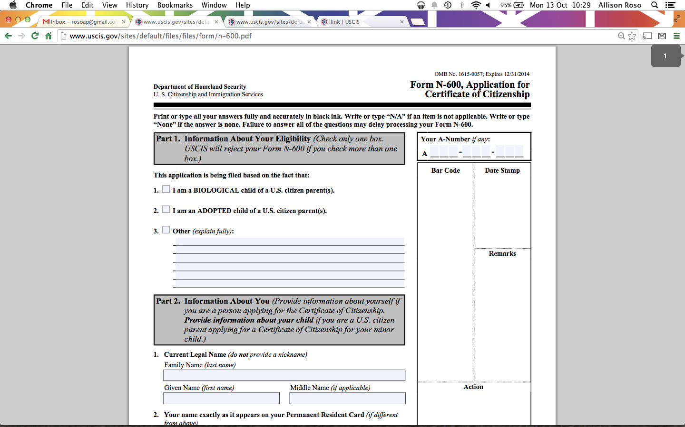
N-600: Part 1
Notes:
One box should be chosen, regardless if the applicant is requesting a certificate of citizenship is based on acquisition or derivation
Also included in the handout is an annotated N-600 form and list of required documentation for each

Slide 20
Applicant’s Demographic Information
Part 2: Information about Applicant
  If applying on behalf of a minor child, fill out information for the child.
  A lot of the same information asked on N-400 (all names, mailing address, SSN, marital history, etc.).

Slide 21
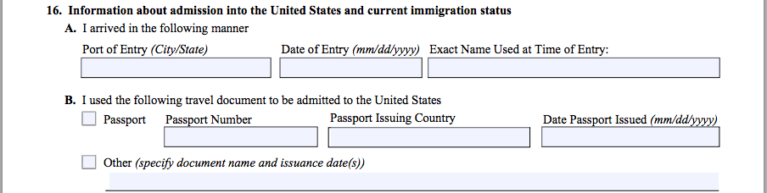
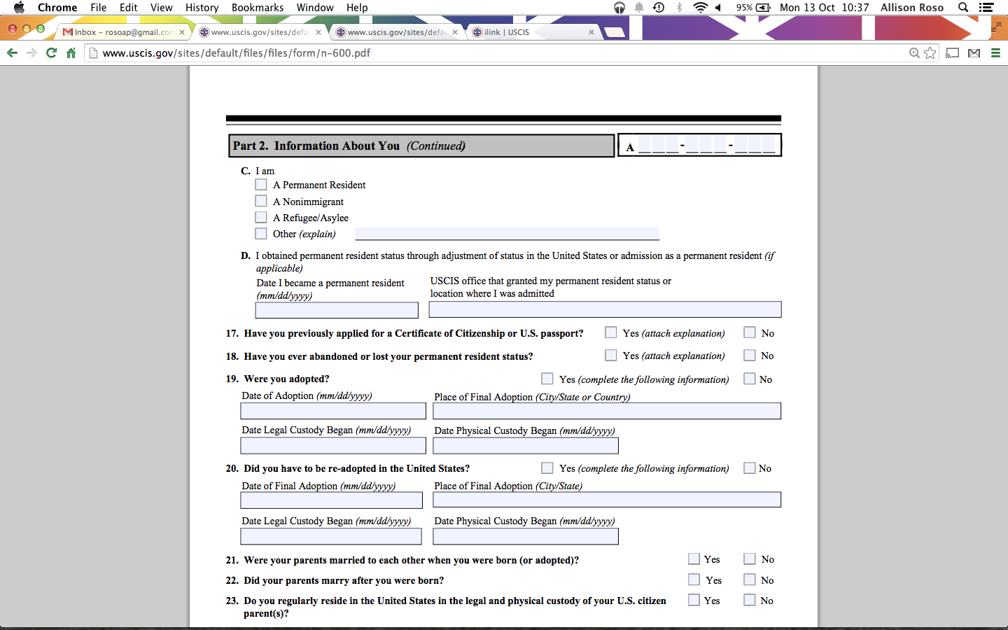
Immigration History
Notes:
Additional information to the N-400 is about the applicant’s immigration history (Part 2, Question 16)
This may be a challenge for some applicants who came to the United States as children and do not have the documents from that time. You can always file a FOIA request to obtain this information if the applicant does not have records and/or their USC parent cannot remember or has passed away.

Slide 22
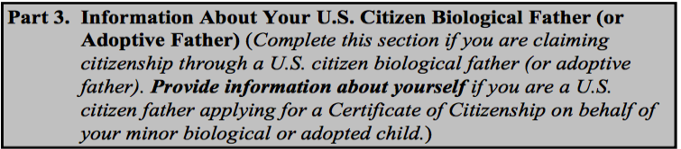
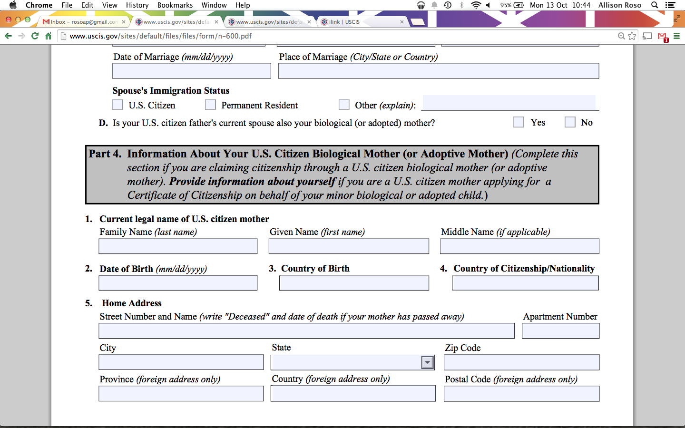
Information about USC Parent(s)
You may fill out one or both Parts depending on which parent is/was a USC.
Notes:
Depending on whether the applicant is applying for citizenship based on the status of their mother or father, they will fill out either Part 3 or Part 4, or if both parents are citizens, both sections
These sections ask for the same information, including:
-Name
-DOB
-Country of birth
-Home address (if deceased, write “Deceased” and date of death)
-How your parent was a USC (birth/naturalization/acquisition)
-Marital history and spouse’s information
If the applicant is requesting a certificate of citizenship based on acquisition, Part 5 must be filled out, which asks for any time the USC parent spent outside of the U.S. between the applicant’s time of birth until the filing of the N-600. (Because there are residency requirements for acquisition)

Slide 23
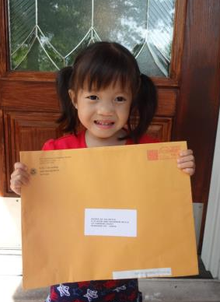
Application Information
Two (2) passport style photos
Application fee for $600
  I-912 Fee Waiver
Copy of green card
Copy of applicant’s birth certificate
Copies of subsequent supporting documentation, as needed
Notes:
The form N-600 itself is not very complicated. The most challenging part is obtaining all of the required documentation to submit with the application.
These documents are required of every applicant. The same evidence for the fee waiver as used for the N-400 can be used for the N-600.
If applying on behalf of a minor child, the documents should be those issued to the minor child.

Slide 24
Supporting Documentation
Birth certificate of USC parent
Proof of parent’s U.S. citizenship
  Birth certificate
  Naturalization certificate
  U.S. issued passport
Parent’s marriage certificate(s)
Proof of residence/physical presence (acquisition only)
Marriage termination(s)*
  Death certificate
  Divorce decree
  Annulment
Proof of legitimation*
Proof of legal custody*
Final adoption decree*
Evidence of all legal name changes*
*if applicable
Notes:
The documents on the left are required of all applicants. The documents on the right may not be required, depending on each applicant’s specific situation.
Legal custody: only needed if the applicant’s parents were separated or divorced, and there was a court decree for custody
Adoption: only if applicant is applying based on their adoption (may also need to submit evidence of any re-adoption in the U.S.)

Slide 25
Proof of Residence/Physical Presence
School records
Employment records
Military records
Deeds, mortgages or leases
Attestations by churches or organizations
U.S. Social Security quarterly reports
Third party affidavits
Notes:
These are only examples. Any document that can attest to the USC parent’s time in the United States can be submitted to show that they meet the applicable residence/physical presence requirements.

Slide 26
Proof of Physical Custody
School records
Medical records
Leases or mortgages
Legitimation documents
Divorce settlement/decree
Pieces of mail (in care of)
Affidavits

Slide 27
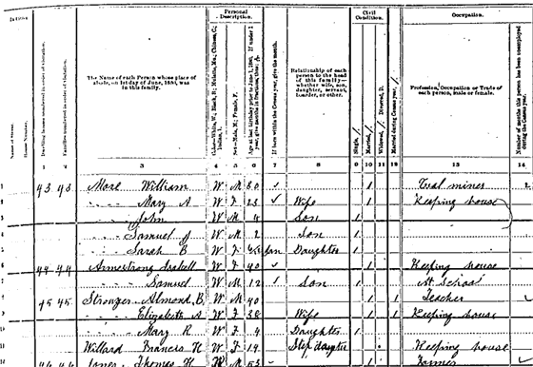
Secondary Evidence: Substitutions
If the applicant is unable to get required documents, they must explain why and may use the following substitutes:
Baptismal Certificate
  Under church seal
  Place and date of birth
  Baptism date
  Parents’ names
  Godparents’ names
School records
  Official letter from authority
  Date of admission
  Place of birth
  Date of birth and age
  Name and residence of parents, at the time
Census Records
  State or Federal
  Name
  Place of birth
  Date of birth or age
Notes:
In many cases, applicants are not able to obtain primary documentation (government issued original documents). If this is the case, applicants may submit secondary evidence to show required information.

Slide 28
Secondary Evidence: Affidavits
Affidavits (signed under the pains and penalties of perjury)
  Written by people with personal knowledge of the claimed event
    Need not be U.S. citizens
    Can be relatives
  Must include:
    Full legal name
    Address
    Place and date of birth
    Relationship
    Detailed information about event and source of knowledge
Notes:
If no other documentation may be obtained, written affidavits that are sworn or affirmed to by two people can be submitted in lieu of documents. It is critical that the person writing the affidavit explains how they came to know the information to which they are attesting.

Slide 29
Filing N-600
All applications and required evidence should be submitted to:
  USCIS
  P.O. Box 20100
  Phoenix, AZ 85036

Slide 30
U.S. Passport
An alternative to the Certificate of Citizenship for some applicants may be applying for a U.S. passport.
  Most common when a parent naturalizes and the LPR child is under 18.
To apply for a U.S. passport, the applicant must provide:
  Foreign birth certificate (with English translation)
  Proof of parent’s U.S. citizenship
  Parent’s marriage certificate
  Statement from USC parent detailing physical presence and residence in the U.S. and abroad before applicant’s birth
Notes:
http://travel.state.gov/content/passports/english/passports/information/secondary-evidence.html
More cost effective ($125) and quicker turnaround

Slide 31
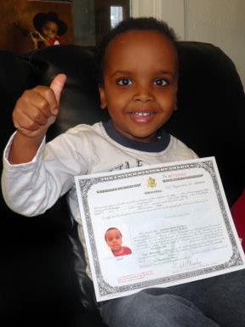
Questions?
  If you have any questions, please contact:
  Allison Roso, GBCI
  aroso@gbcinitiative.org
  (617) 530-1029
THANK YOU!

