Slide 1
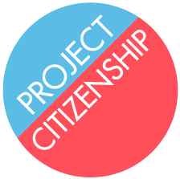
Project Citizenship
Project Citizenship (PC) paves an easier path to citizenship for eligible immigrants. Lack of knowledge about how the process works and high legal fees have left many unable to gain access to citizenship.
Nationally, 8.8 million immigrants are eligible for citizenship. 300,000 live in Massachusetts.
Due to financial, legal, and bureaucratic obstacles, only 10% of eligible immigrants apply for citizenship, leaving millions of people without access to the rights and privileges of citizenship.
Citizenship creates stability for individuals, their families, and our shared communities. When immigrants gain the rights, privileges, and obligations of citizenship, they are able to contribute to the vitality of our communities and our democracy as a whole.
PC’s efficient and cost-effective model represents an innovative pathway to increasing the number of naturalized U.S. citizens. It offers immigrants information, free legal expertise, and a streamlined process, facilitated by trained volunteers and community partners. As a result of these efforts, 95% of PC’s clients successfully become naturalized citizens.
Founded: 2014
Current annual Budget: $617,995
Contact: Veronica Serrato, Executive Director
Phone: 617.694.5949
Email: vserrato@projectcitizenship.org
Web: www.projectcitizenship.org
Investment Opportunity
Project Citizenship seeks an investment of $1.4M over the next two years to meet the growing number of immigrants who are ready to apply for U.S. citizenship. PC plans to expand services in Boston and beyond, with a goal of naturalizing 10,000 immigrants by 2019. The investment will be used to increase its reach by hiring key staff members, increasing the number of volunteers, enhancing volunteer training, and expanding partnerships.
Two-Year Goals
Expand the service area to include Lowell, Brockton, Chelsea, and other gateway cities
Develop an intake center, staffed by volunteers
Double the number of staff, including adding a staff attorney to provide expertise in immigration law
Increase immigrant and volunteer outreach to enable substantial growth in the number of immigrants served
Ways to Invest
Financial
$50,000 helps fund a staff attorney
$25,000 underwrites a citizenship outreach campaign through ethnic media
$5,000 funds design and implementation of a training webinar for volunteers
$1,000 provides individual legal representation to five immigrants
In-Kind
Photography and videography that capture the immigrant experience
Telephone intake line staffed by trained volunteers
IT, website maintenance, and Salesforce support
Graphic design, marketing, and printing
Computers and iPads
Notes:
With its streamlined process and expert training model for volunteers and community partners, deep collaborations and extensive networks, the PC model can .

Slide 2
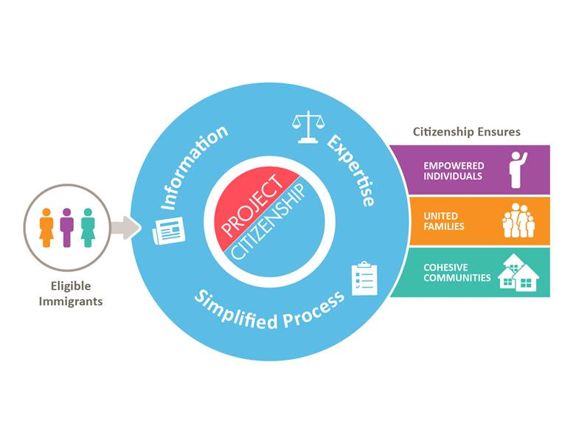
Leadership & Governance
Attorney Veronica Serrato is PC’s first Executive Director. Veronica, whose parents are naturalized citizens from Mexico, graduated from Harvard University and the B.U. School of Law. She is the recipient of the B.U. School of Law 2017 Silver Shingle Award for Service to the Community.
Project Citizenship is governed by an 11 member Board of Directors, two of whom are naturalized citizens. PC’s Board Chair is Attorney Jim McGarry, partner at Goodwin Procter. Jim’s enthusiasm and commitment to immigrants has expanded PC’s pro bono relationships with law firms and in-house counsel. Jim received the 2017 Robert B. Fraser Award for Pro Bono Excellence for his outstanding contributions.
Project Citizenship Program Model
Insert Model Graphic Here
PAVING the path to the American Dream
In 2016, PC staff and volunteers served 1,507 immigrants from 91 countries. This success represents exponential growth from 142 in 2014. 95% of PC’s clients achieve citizenship, even with challenging issues. 19% of clients are exempt from the English language requirement due to age or disability. PC obtains fee waivers for 75% of its clients, those who cannot afford to pay the $725 filing fee. PC has achieved this remarkable growth and success thanks to a highly effective and measurable model.
Providing Information
Project Citizenship engages ethnic, mainstream, and social media to promote U.S. citizenship and encourage immigrants to initiate the naturalization process. PC publishes and disseminates culturally appropriate messages in seven languages. As a first step, PC’s staff screens prospective clients in their first language to ensure that they are eligible for citizenship and have all their supporting documents in order.
Engaging Volunteers
In 2016, Project Citizenship recruited and trained 624 pro bono attorneys and students from eight law firms and four law schools. In 2017, PC will engage at least 750 volunteers.
Simplifying the Process
PC’s trained volunteers work one on one with clients in one-stop workshops to complete the 20-page naturalization application. Once an application is filed, PC staff tracks all individual cases; from submission, fingerprinting, interviews, and culminating in the oath of citizenship.
Amplifying Impact Through Technical Assistance
PC provides technical assistance and legal expertise to 16 community partner organizations throughout New England that help 2,400 additional immigrants annually through the naturalization process. Working closely with community partners allows PC to increase its impact while reaching linguistically or geographically isolated immigrant communities.
I was intimidated by the citizenship process, but Project Citizenship’s help made it easy and clear. As a citizen, I am no longer a guest or a spectator; I am home.
elizabeth Harroo Citizen of the United States and Trinidad and Tobago
Place PHOTO HERE

Slide 3
Benefits of citizenship
Project Citizenship’s impact starts with individuals and extends to families as well as communities. Because 95% of PC’s clients successfully obtain citizenship, the benefits of citizenship and civic engagement are amplified throughout the Commonwealth.
Empowered Individuals
Immigrants who become citizens earn the rights and privileges of U.S. born citizens. They are able to vote, obtain government jobs, run for elected office, travel freely with the security of a U.S. passport, and are eligible for federal student loans. These benefits lead to increased earning power and a stronger sense of security.
United Families
Children holding green cards automatically become U.S. citizens when a parent takes the naturalization oath. Citizens have the highest priority when filing family-based petitions to bring relatives to the U.S. for reunification.
Cohesive Communities
Research shows that cities and neighborhoods with higher naturalization rates benefit from a more stable workforce and a more vital economy. Moreover, civic engagement deepens when immigrants cast their votes and run for public office to help create a representative government.
Volunteering with immigrants and helping with their applications for citizenship encouraged me and renewed my faith in people. Citizenship provides real security for immigrants and Project Citizenship makes the complicated process doable and approachable. The excitement that Project Citizenship brings to their workshops is infectious.
Joel Lehrer Goodwin Procter
Financial Sustainability
Project Citizenship was launched through the vision of Larry and Atsuko Fish and generously funded by the Fish Family Foundation to advance U.S. citizenship services. With the current environment on the subject of immigration, the demand for PC’s assistance has increased dramatically. PC is well poised to capitalize on its proven model and to grow its funding base with investments from foundations, corporations, and individuals.
Key Investors
The boston foundation
Fish family foundation
Foundation for metrowest
Partners
Boston college law school
Boston university school oF LAW
Goodwin procter
Harvard law school
ropes & gray
Wilmerhale
Revenue by Source

Slide 4
Success Story:
The Merida Family
In 2001, Mariana Merida arrived in Boston from Guatemala with $50 in her pocket and a sick child in her arms. She sought treatment for cystic fibrosis for her daughter at Children’s Hospital. It took the Merida family five years to obtain green cards.
In 2014, Mariana and her husband had already been eligible for U.S. citizenship for three years but had not applied. Mariana saw a Facebook post and contacted Project Citizenship, which helped them through the process.
Mariana became a citizen three days before her oldest son, Jose, turned 18, allowing him to automatically become a U.S. citizen, just in time for college financial aid applications. Mariana’s husband did not pass his first civics exam but succeeded on his second attempt.
Thanks to the help of PC, six members of the Merida family have achieved U.S. citizenship. Ana and Sebastian attend Brookline High School. Jose is studying business at Framingham State University and is the first in his family to attend college.
Program Performance and Organizational Health
Below is a summary of the key measures that Project Citizenship tracks to demonstrate progress, create internal accountability, apply lessons learned, and adjust strategy as necessary. Note: Project Citizenship has committed funding of $300K for each of fiscal years 2018 and 2019, leaving $1.4M in needed investment over the next two years.
 | FY 2017 | FY 2018 (P) | FY 2019 (P)
Program performance
Number of citizenship applications filed | 1,998 | 3,009 | 4,993
Applications filed by partner organizations | 2,405 | 3,015 | 4,011
Number of volunteer hours | 3,996 | 6,024 | 9,986
Number of law firms engaged | 8 | 10 | 12
Organizational health/capacity-building
Total Staff | 3.5 | 7 | 9
Board Members | 11 | 13 | 15
Fundraising Plan | Implement | Revise/ Implement | Implement
Total Revenue | $617,995 | $700,000 | $1.3M
Social Impact
Through its extensive volunteer training, partnerships, and workshops, Project Citizenship works to ensure that all eligible immigrants are given the tools they need to apply for and obtain U.S. citizenship. Below are seven indicators that Project Citizenship will track to measure its progress as it works to ensure that all eligible immigrants can obtain citizenship.
Social Impact Indicators marked below with (*) will be tracked with the help of SIF partner, The Analysis Group, by November 2017.
INDICATOR | 2017 (Projected)
PC applicants who become citizens | 95%
Amount of money PC saves clients in filing fees | $1.1M
Amount of money PC saves clients in legal fees | $3.6M
Number of children who automatically derive citizenship with PC’s assistance | 144
Clients who express satisfaction with PC’s services | 100%
New citizens who feel safer due to citizenship(*) | TBD
New citizens who register to vote and who vote(*) | TBD

